Slide 1
Unmanned Vehicle
Control and Path Planning
By Chinemelu Ezeh

Slide 2
An autonomous vehicle as used here is a land vehicle that moves without human assistance

Slide 3
Motivation and Objectives
Interleaved Execution and Planning
Produces path and motion commands simultaneously.
At each time step, the path produced also avoids obstacles.
At each time step, path is globally optimal
No need for local path repairing algorithm
Report on Practical Focussed Dynamic A-star Algorithm (D*)
A possible candidate for interleaved path planning.
Converts path planning to graph search where arc cost changes dynamically.
Completed version of D*
D* successfully used in DARPA challenge
Investigate Integration of Optimal Control
Implement path following while minimising energy.
Solve using a model predictive control (MPC) framework to consider future system constraints and conditions
Develop constrained optimisation algorithm to solve MPC problem.
Holistic Research and Learning
Combining concepts from a lot of topics to demonstrate a mastery of Electrical and Electronics Engineering.
Apply complex concepts in a novel and hands on way
Notes:
What is the motivation for this project?

Slide 4
Presentation Overview
Literature Review
Investigate and report existing navigation systems.
Mathematical Modelling
Derive crucial equations for the system
Optimisation and Optimal Control
Formulate optimal control problem in an MPC framework
MPC Result
Develop Optimisation Technique to solve problem
Discussion of Implications of MPC on navigation System.
Navigation System and Path Planning
Demo
Notes:
Make into diagram showing design directions.

Slide 5
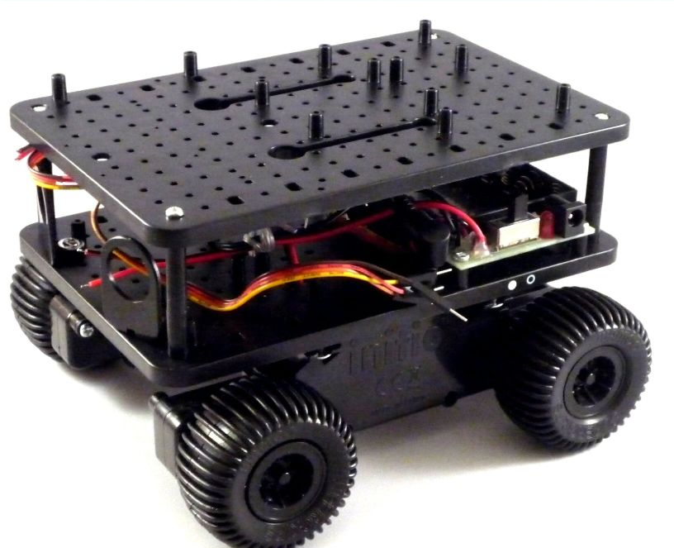
Deliverables
Simulation
Path following with MPC
Feasible Trajectory Generation
D* algorithm simulation
Physical System
A robot prototype that uses D* to move around.
Robot software and electronic system is mostly made from scratch using basic materials.
Chassis is third party.

Slide 6
Literature Review (Mobile Robots)
Chosen Component or Method
Similar Component
Laser Range Finder
Used for sensing environment
Accurate
May be sensitivity to obstacle material
Medium price range
Fix Cell Map Decomposition
Tessellate the map with uniform grids
Popular variant used is the occupancy grid
Each grid is either occupied or empty
Allows for high location resolution for path planning
Sonar Scanner
Used for sensing environment.
Cheap
Inaccurate around wall edges
Less sensitivity to interference
Exact Cell Map Decomposition
Approximate obstacles using polygons
Divide free space into sections.
Convert adjacent free polygons to connected nodes on a graph

Slide 7
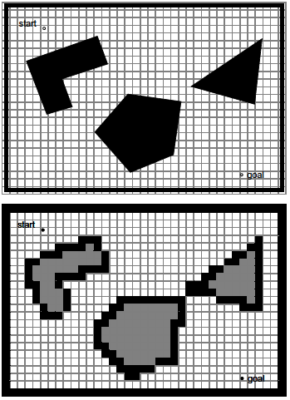
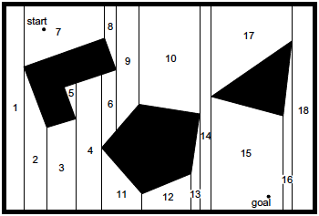
Literature Review (Mobile Robots)
Chosen Component or Method
Similar Component
Exact Cell Decomposition
Fixed Cell Decomposition.
(Illah R. Nourbarkhsh, Roland Siegwart , 2004)

Slide 8
Literature Review (Mobile Robots)
Chosen Component or Method
Similar Component
D* Path Planning
Solves both Path Planning and Obstacle avoidance.
Solution is globally optimal at each time step
No need for local map (i.e. localised map near robot’s location to modulate path when an obstacle is observed)
Integrated Planning and Execution Architecture
Solve both path planning and motion commands at each time step.
No need for specialise obstacle avoidance algorithm like Bug2.
Execution time can be made negligible
Combined Grassfire and Bug2
Grassfire is a breath first search algorithm for constrained space.
Bug2 uses tactile sensing to follow the contours of an obstacle and then departs from it at the point where distance to goal is shortest.
No opportunity for optimal path planning
Episodic Planning Architecture
Most popular architecture.
Vehicle moves according to global path.
When an obstacle is detected, obstacle avoidance is initiated.
If obstacle avoidance fails, global path is recomputed.

Slide 9
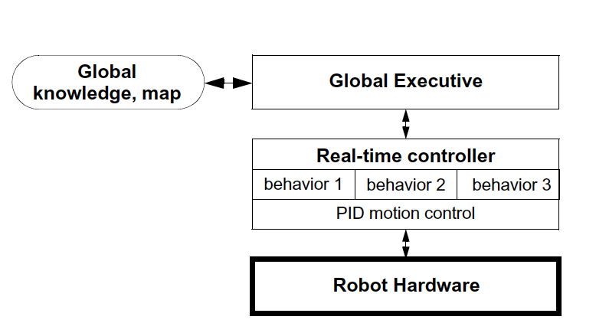
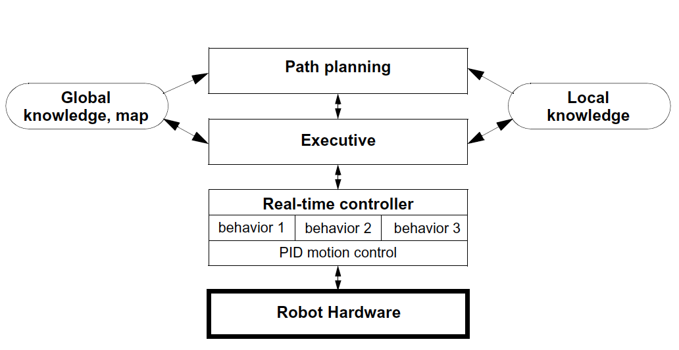
Literature Review (Mobile Robots)
Chosen Component or Method
Similar Component
Interleaved Planning and Execution
Episodic Planning
(Illah R. Nourbarkhsh, Roland Siegwart , 2004)

Slide 10
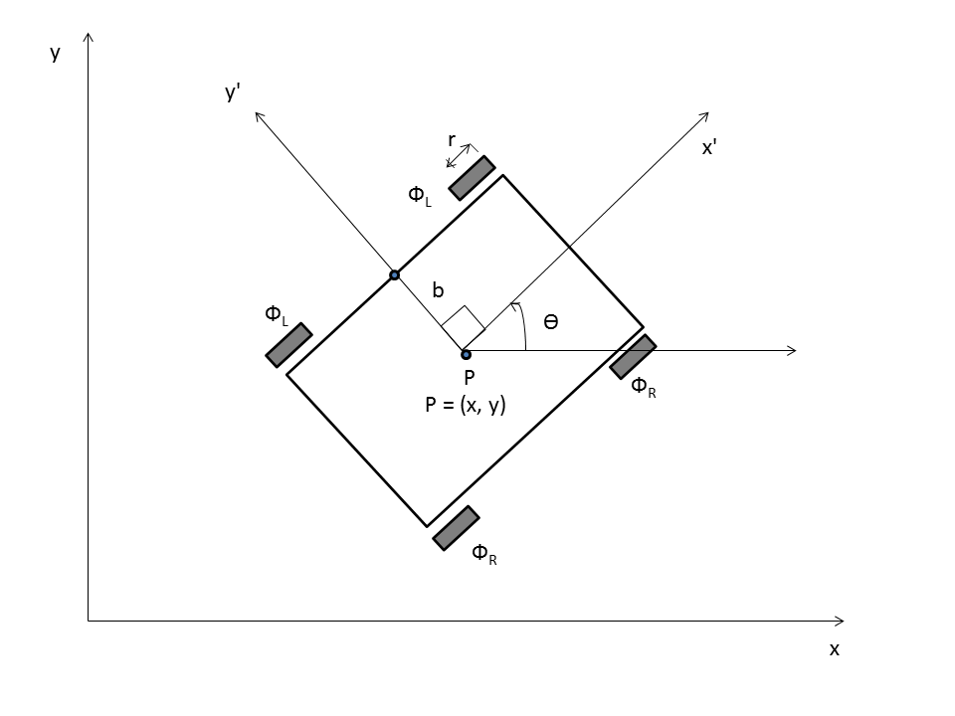
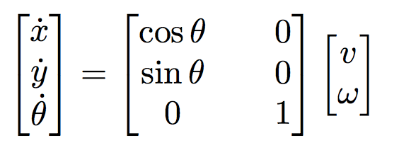
Mathematical Modelling
Robot uses differential drive.
We can describe the kinematics using
Where v and ω are the linear and angular velocity of the vehicle.
This forms the configuration space over which we control the system.

Slide 11
Optimisation and Optimal Control
Motivation
Classical control techniques e.g. Nyquist plot and Laplace transform are inadequate for Multiple Input Multiple Output systems (MIMO).
Optimal control is excellent for MIMO. Given an optimal criteria called the objective function. Optimal control finds the best configuration for that particular kind of system.
Moreover optimal control converts problems into forms that can be solved using numerical optimisation techniques.
Optimisation
We are concerned with minimising distance from a path and energy used in motion.
The system has constraints on speed.
These can be formulated as constrained quadratic optimisation.
Solving constrained quadratic problems
Employ the active-set method as opposed to interior-point method.
Active-set method is the most efficient for medium sized problems such as ours.
Active-set Operation
It works be solving constrained optimisation sub problems at every time step.
If the research direction generated violates some constraints that are not in the active set, we reduce the direction so that no constraint is violated.
We add any active constraint and remove any inactive constraint from the working set and iterate till research is zero.
At this point, we find our answer.

Slide 12
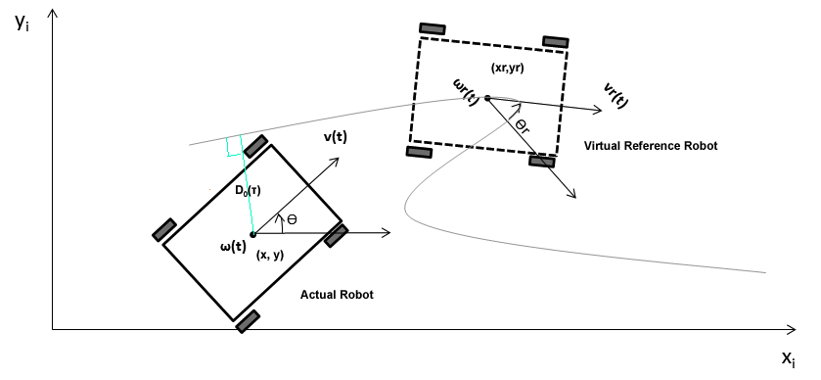
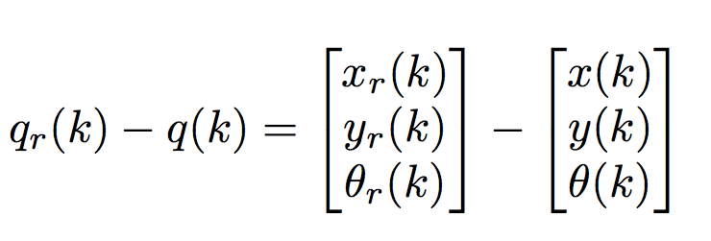
MPC Formulation
The problem is, “ assuming we have a reference vehicle moving on a path in front of our own vehicle, how do we follow it in an optimal way?”
Mathematically, for all time we want to minimise the error in the distance given by

Slide 13
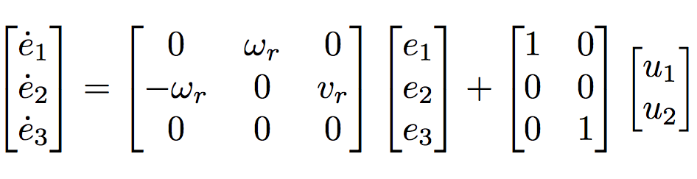
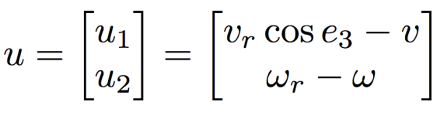
MPC Formulation
To achieve our aim, we linearise the state space model for the error, e and solve a regulation problem such that error tends to zero.
The linearized system is given as
where
We aim to minimise both e and u.
To complete formulation we need speed constraints so that we finally achieve MPC formulation.

Slide 14
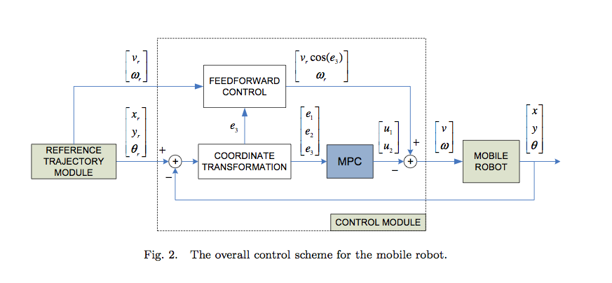
MPC Controller
We feed in the
reference trajectory
values and use MPC
to generate v and ω
that are then used
by the robot to move.
(I. Maurovic, M. Baotic, and I. Petrovic., 2011)

Slide 15
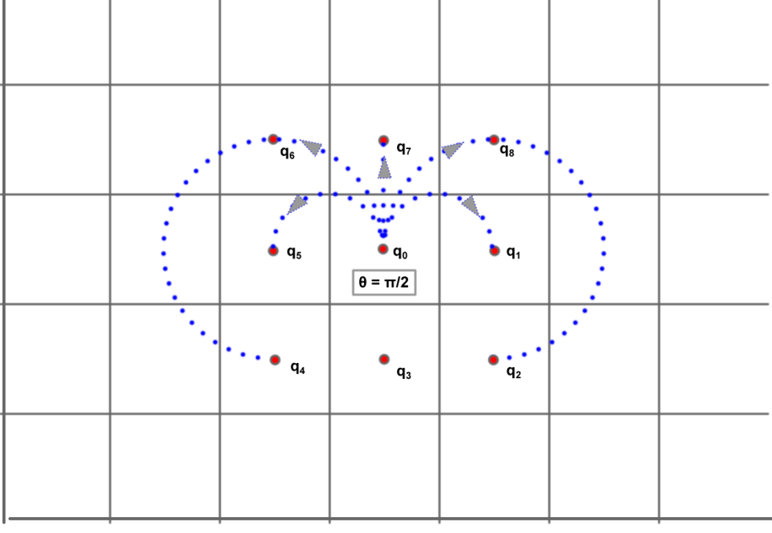
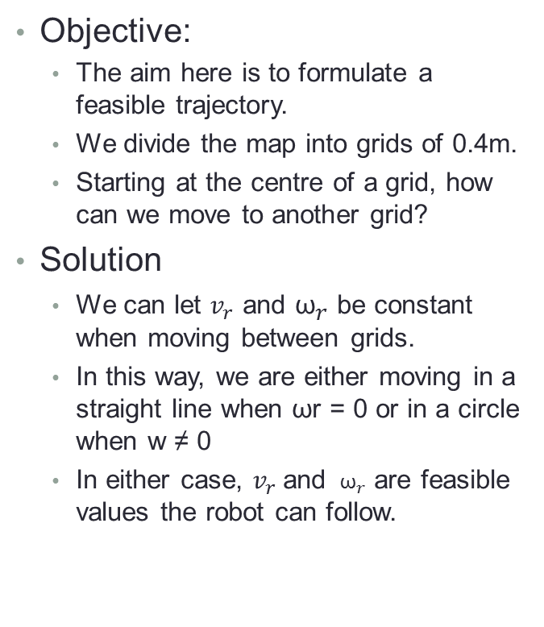
Path Generation
Objective:
The aim here is to formulate a feasible trajectory.
We divide the map into grids of 0.4m.
Starting at the centre of a grid, how can we move to another grid?
Solution
We can let $v_{r}$ and ${\text{ω}}_{r}$ be constant when moving between grids.
In this way, we are either moving in a straight line when ωr = 0 or in a circle when w ≠ 0
In either case, $v_{r}$and ${ \text{ω}}_{r}$ are feasible values the robot can follow.
Possible states for θ = π

Slide 16
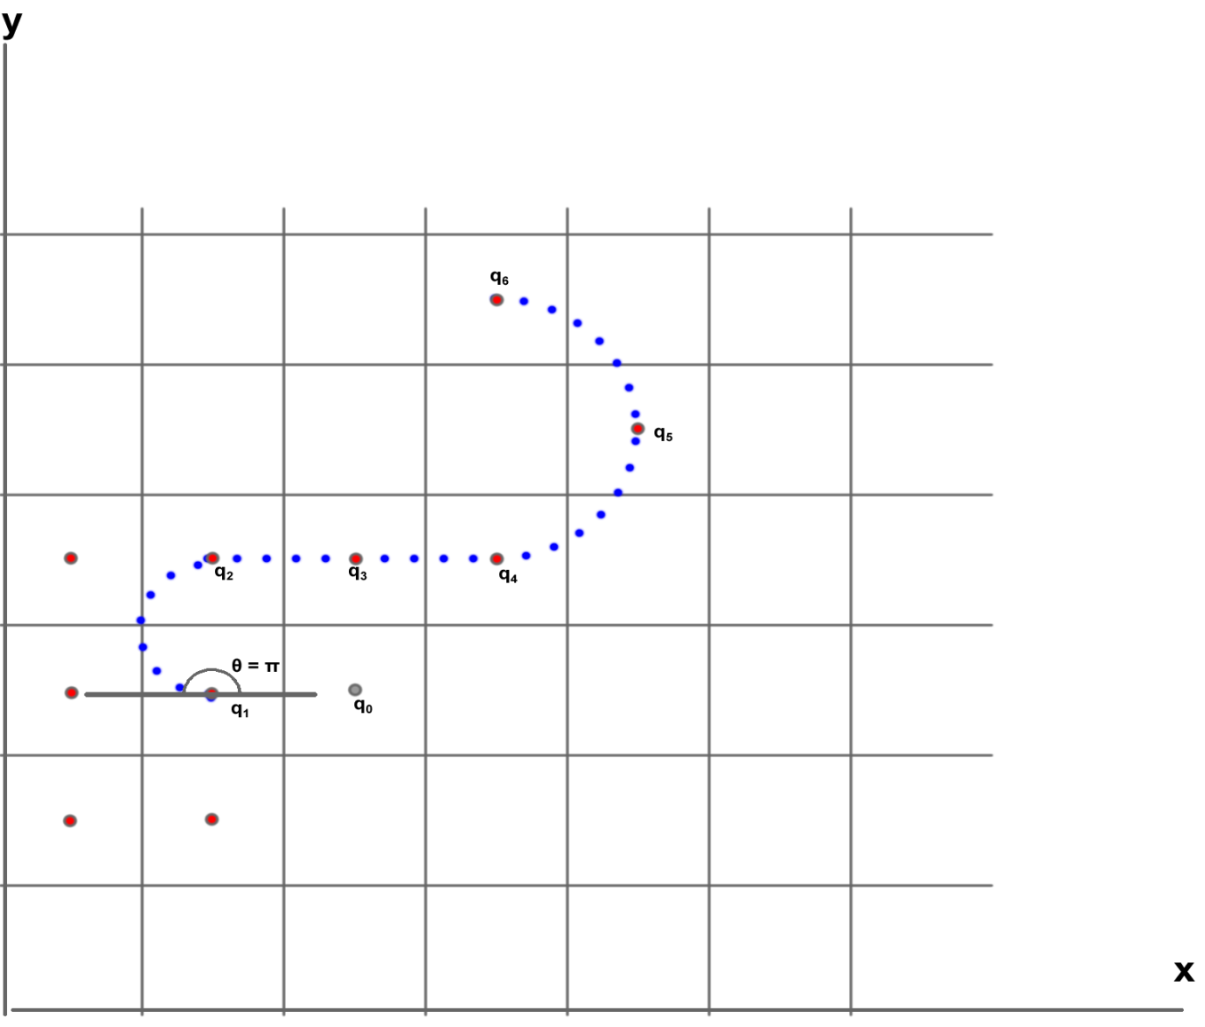
Path Generation
We can chain together movement between grids to form a full reference trajectory that is feasible.
Such a trajectory can be generated with our path planner

Slide 17
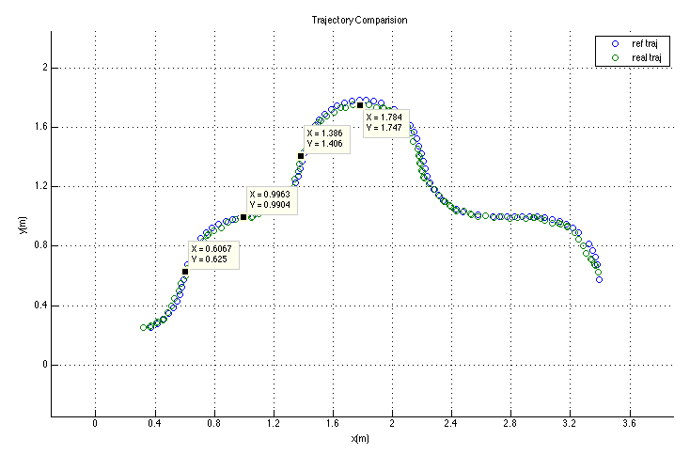
MPC Results
Tracking a random trajectory with MPC

Slide 18
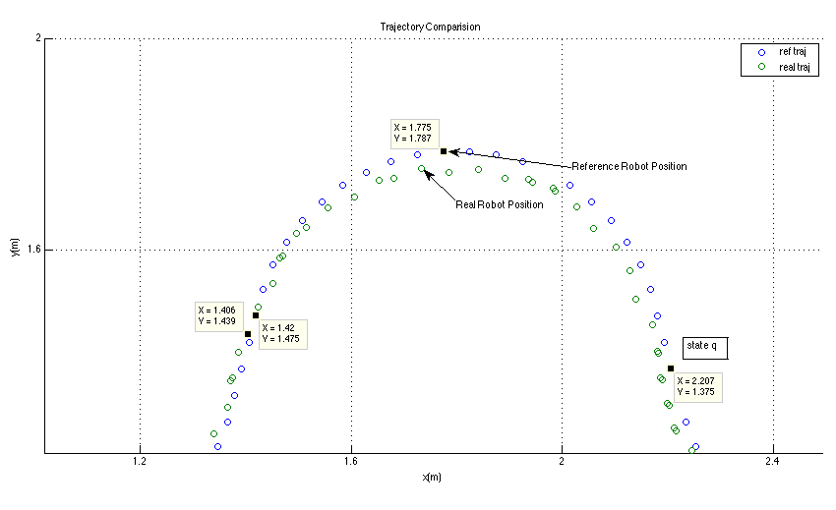
MPC Results
Tracking a random trajectory with MPC

Slide 19
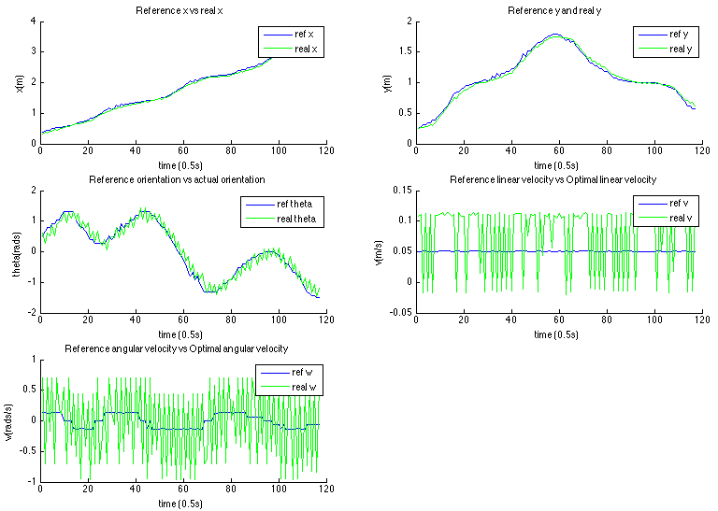
MPC Results
Tracking a random trajectory with MPC
Notes:
Why are the shapes for v and w the way they are?

Slide 20
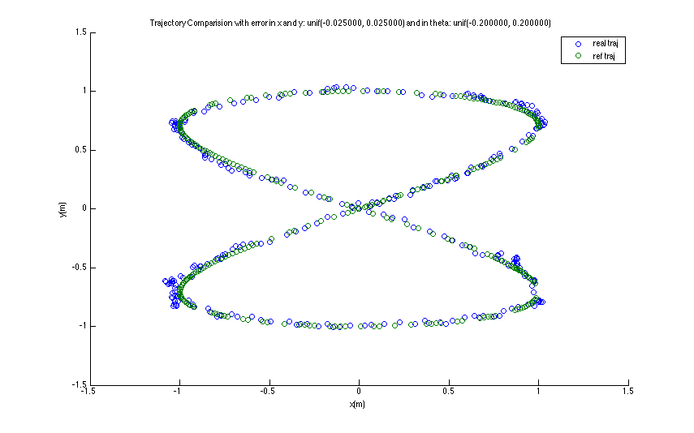
MPC Result

Slide 21
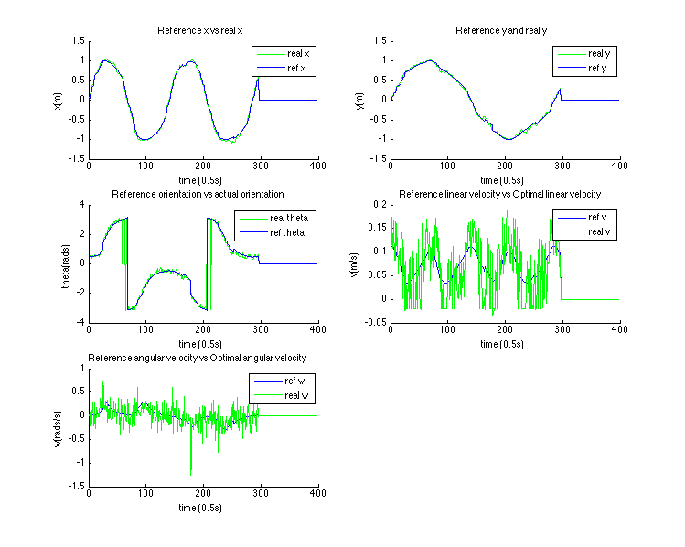
MPC Result

Slide 22
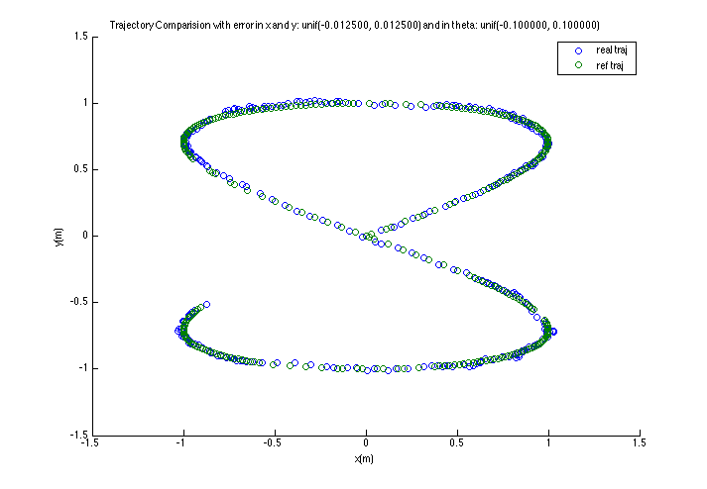
MPC Result

Slide 23
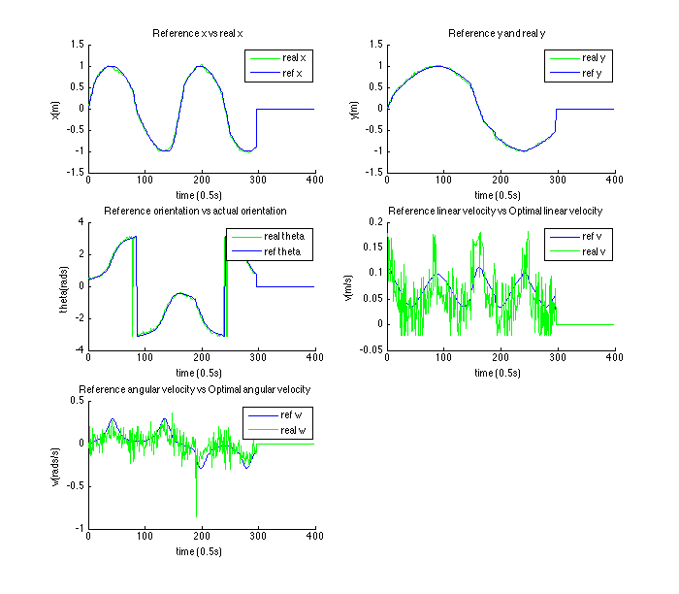
MPC Result

Slide 24
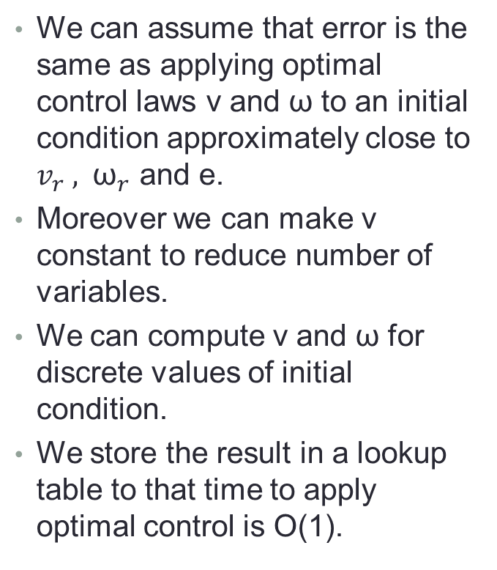
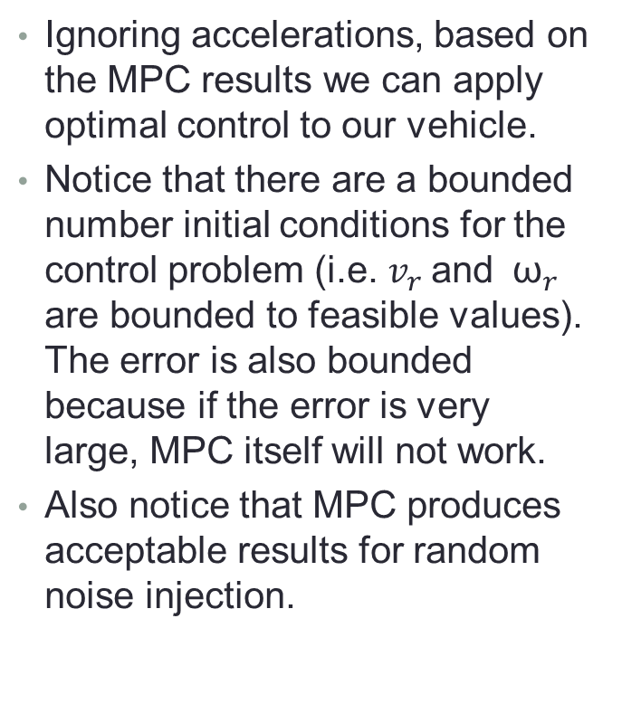
MPC Result Discussion
Ignoring accelerations, based on the MPC results we can apply optimal control to our vehicle.
Notice that there are a bounded number initial conditions for the control problem (i.e. $v_{r}$and ${ \text{ω}}_{r}$ are bounded to feasible values). The error is also bounded because if the error is very large, MPC itself will not work.
Also notice that MPC produces acceptable results for random noise injection.
We can assume that error is the same as applying optimal control laws v and ω to an initial condition approximately close to $v_{r} ,$ ${ \text{ω}}_{r}$ and e.
Moreover we can make v constant to reduce number of variables.
We can compute v and ω for discrete values of initial condition.
We store the result in a lookup table to that time to apply optimal control is O(1).

Slide 25
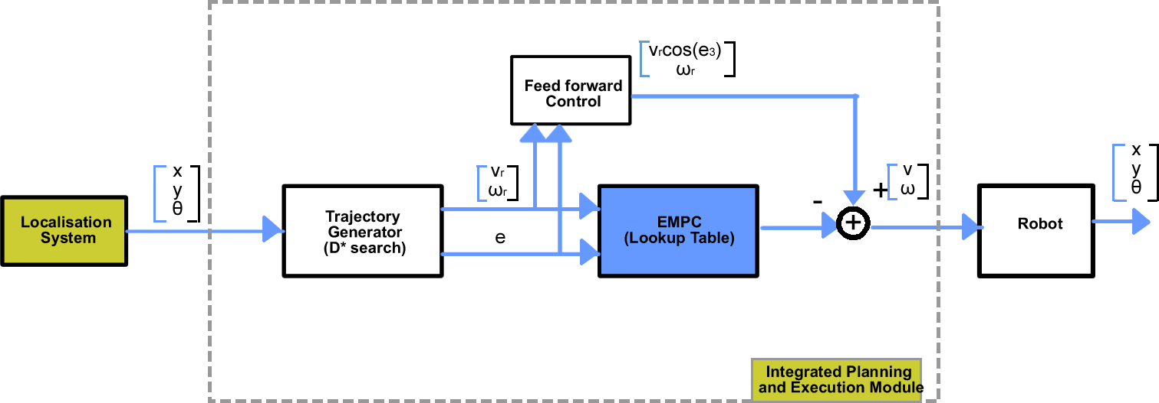
MPC Result
The system diagram for the resulting explicit MPC is:
Fig: Integrated Planning and Execution using Lookup Table for MPC

Slide 26
Navigation in a Physical System
Operation Overview
Simulation has given a good insight into design feasibility.
To implement navigation in physical system, it is sufficient to first implement Focussed D* with simple controls.
So when D* finds a pat, we first turn in the direction and the move in the direction.
This forms a basic navigation system that can be improved to incorporate optimal control.
System platform is the Robotic Operating System (ROS).
ROS allows for multi-computer, multi-process communication.
D* Algorithm Basics
Grid locations are represented as states and they form nodes on a graph.
The objective is to find a sequence leading to the goal state.
States are placed on an open list to be expanded.
Obstacles in a state increase path cost from the state.
When the path cost is different from expected value, optimal path is recomputed.

Slide 27
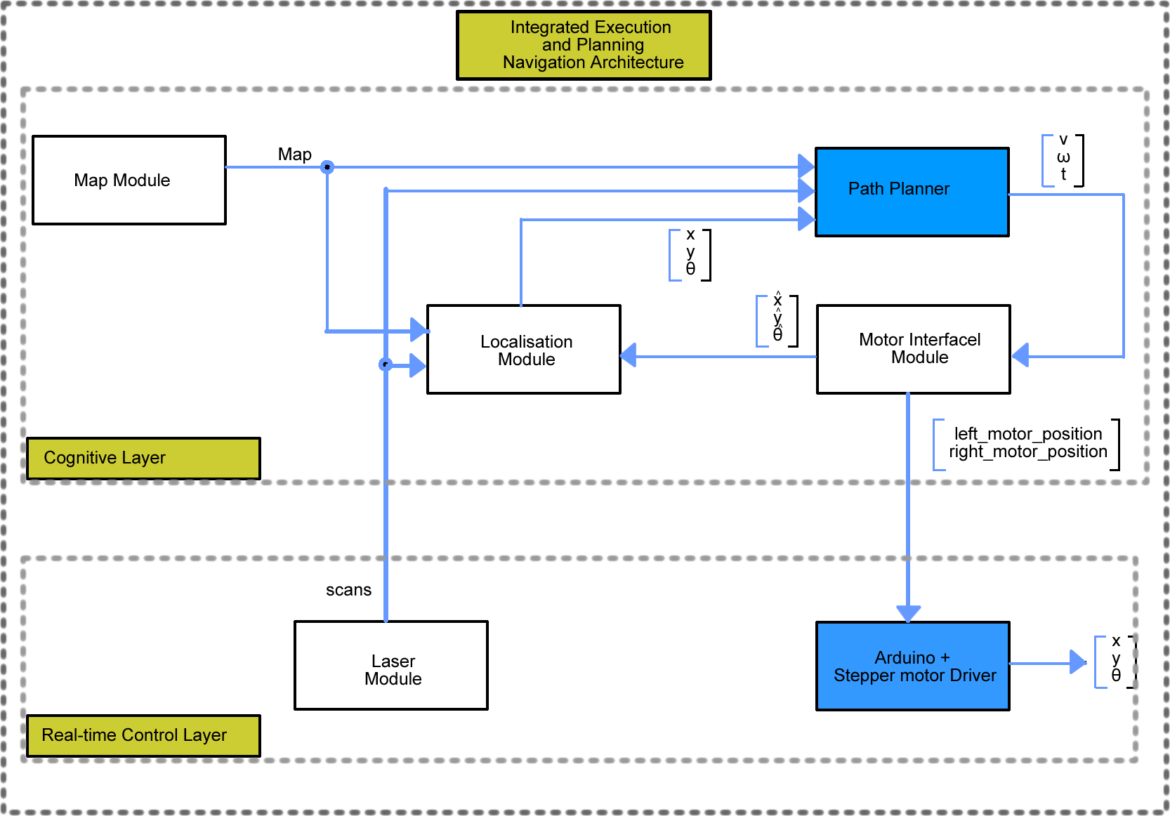
Navigation System High level Design

Slide 28
D* Operation in ROS
Robot moves around using an open loop control.
The navigation runs in a simulation and sends commands to the motors to mimic simulation.
Very basic position estimation that does not guarantee accuracy.
Errors in obstacle estimation can cause undesired movements.

Slide 29


Slide 30
Conclusion
We have provided sufficient proof of concept for implementing interleaved planning and execution.
We have shown in simulation how optimal control can be integrated into the system.
Using explicit MPC, we can guarantee applying optimal control in O(1) time.

